Slide 1
Introduction
Title: Telecom Customer Churn Analysis
Subtitle: A Journey through Churn Analysis using PowerBI
Presenter's Name: Kunal Batsa

Slide 2
What is Churn Analysis?
Churn Analysis is the process of understanding and managing customer attrition, commonly referred to as "churn." Churn occurs when customers stop using a company's products or services. In our telecom context, it means customers terminating their contracts.

Slide 3
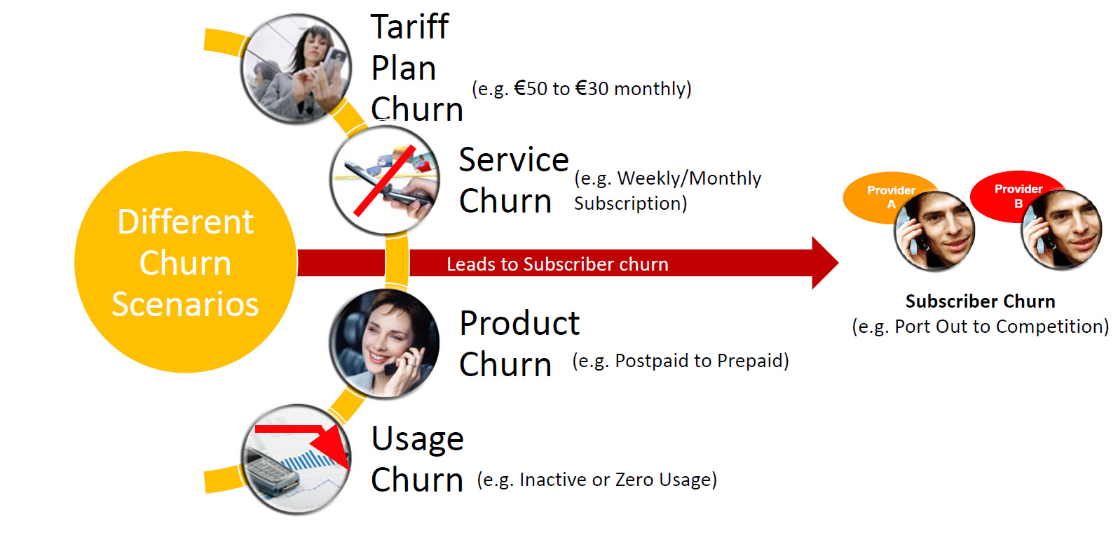
Subscriber churn can be in different forms

Slide 4
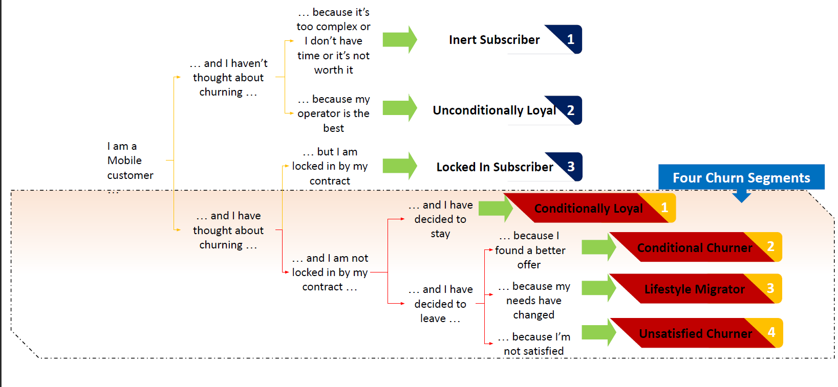
Decision Cycle of a subscriber

Slide 5
Telecom Customer Churn Analysis
Business Needs :
The business needs for creating a telecom customer churn analysis using Power BI include identifying factors causing customer churn, improving customer retention rates, reducing customer acquisition costs, and ultimately improving business profitability. By analyzing customer behavior and identifying trends, the business can implement targeted strategies to reduce churn and retain customers, leading to increased revenue and success.

Slide 6
Business Issue Understanding
Customers in the telecom industry are hard-earned. Any telecom company don’t want to lose them
The retention department is here to get customers back in case of termination.
Currently, they get in touch after the customers have terminated the contract, but this is reactionary. It would be better to know in advance who is at risk.
The Management would like to know more about their customers, visualized clearly so that it’s self-explanatory for the management.

Slide 7
Keeping in mind the life cycle of a data analyst project
Business Issue Understanding Data Understanding Data Preparation
EDA and Modeling
Validation
Visualization and Presentation

Slide 8
After understanding the business requirement, I have created 3 dashboard :
Demographics Information
Customer Account Information
Services Information

Slide 9
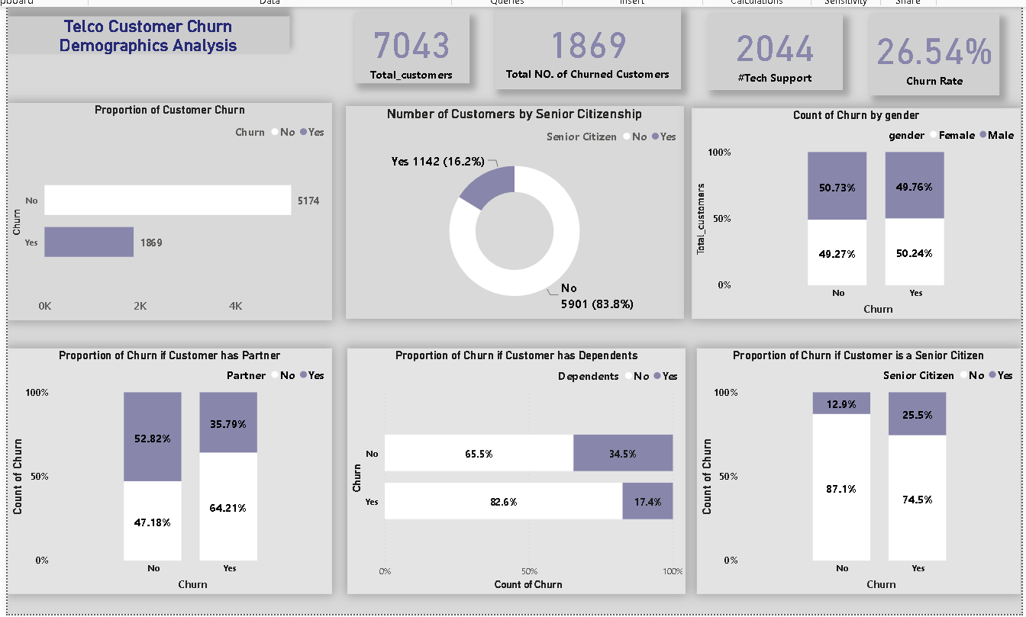
Demographics Information

Slide 10
Findings
There were 7043 subscribers (customers) this month. 1869 churned. The churn rate was 26.54%.
50.24% and 49.76% of customers who left the company were women and men respectively.
74.5% of customers who left the company are not senior citizens. This shows that the churn rate is higher among the younger population.
On partner analysis, 64.21% of those who left had no partners. Again, this can be attributed to the churn rate being higher among the younger customers.
Of the customers who left, 82.6% had no dependents.

Slide 11
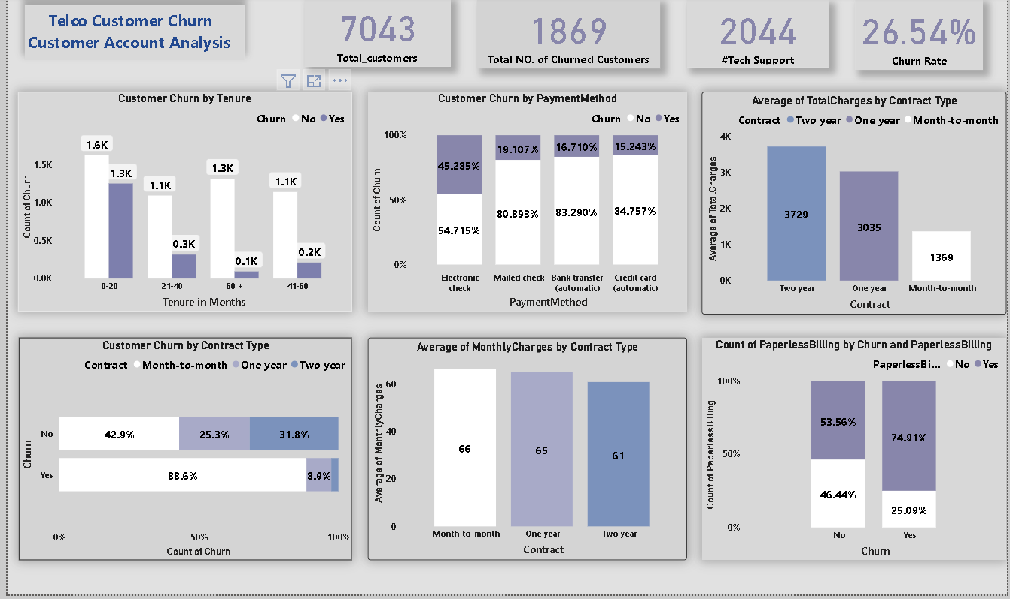
Customer Accounts Overview

Slide 12
Findings
Around 1.3K of customer churn were customers who had been with the company for less than 20 months (new customers).
The majority of customers who left the company were on the month-on-month contract type(86.6%).
Of the customers who left 45.29% used electronic check, 19.20% used mailed check, 16.73% used bank transfer, 15.24% used credit card as payment method.
74.91% of customer churn were customers who had subscribed to paperless billing.
The average monthly charges were highest for customers with the month-on-month contracts but their total charges yearly were much lower. On the other hand, the average monthly charges were lowest for customers with two year contracts but their total charges were much higher.

Slide 13
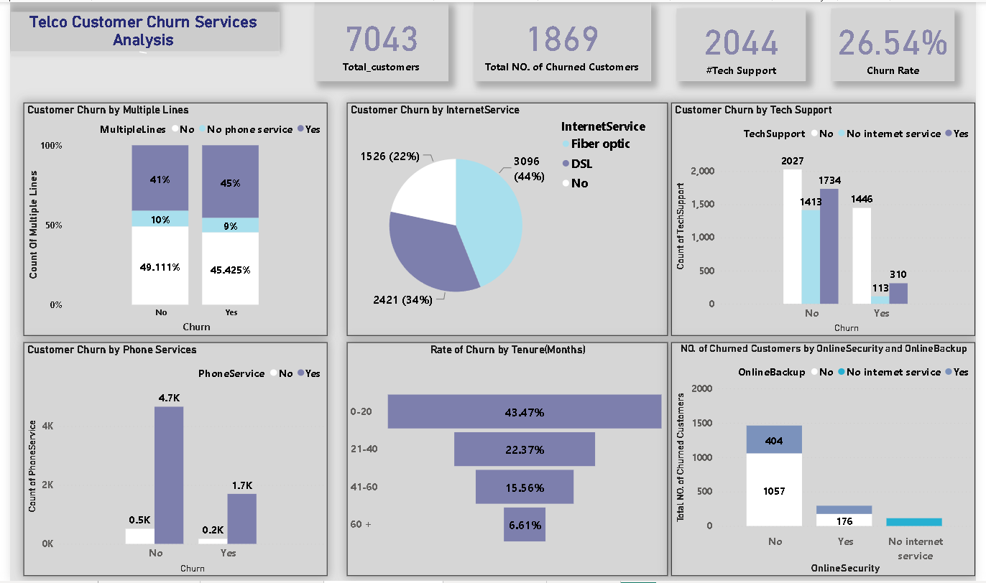
Services Overview

Slide 14
Findings
Out of the customers who left, 45.48% had phone service and multiple lines and 45.42% had phone service but didn’t have multiple lines. They still left anyway. This suggests that multiple lines and phone service were not key influencers of customer churn.
44% of customers who had fiber optic left, 34% of those who had DSL left .This suggests that Fiber optic could be an issue and churn is likely to increase among the customers who have subscribed to it.
1446 customers who didn’t get tech support had churned. This suggests that the tech support could be an issue as well.
1057 customers who didn’t have online security had churned whereas only 176 customers had churned who had online security. This shows a huge difference in the number of churn and this could also be one of our issue

Slide 15
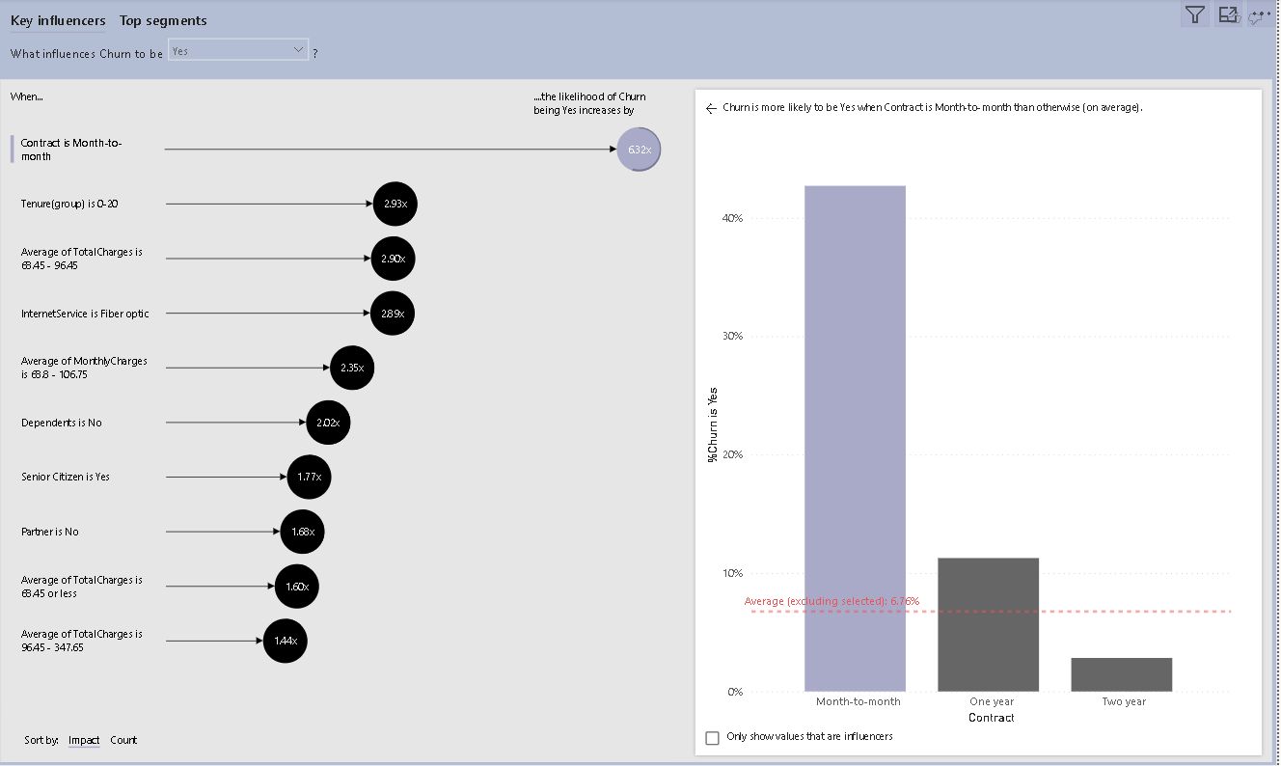
The Analysis To make the right recommendations, I had to determine the key factors that drove customer churn . Here are my findings.

Slide 16
Findings
1.From the findings, when contract is month to month type the likelihood of churn being yes increases by 40%.
2.From the findings, on average when the average total charges decreases, the likelihood of customers leaving increases. In short, what the data is saying is that customers with high total charges are less likely to leave. This translates to senior citizens with two year contracts being less likely to leave.
3.On average, when the average number of tech tickets go up, the customer is likely to leave the company.
4.When the average monthly charges go up, customer churn is likely to occur especially because monthly charges are higher for month-on-month customers who we have earlier seen to be the younger population who have been with the company for less than 20 months on their way out.

Slide 17
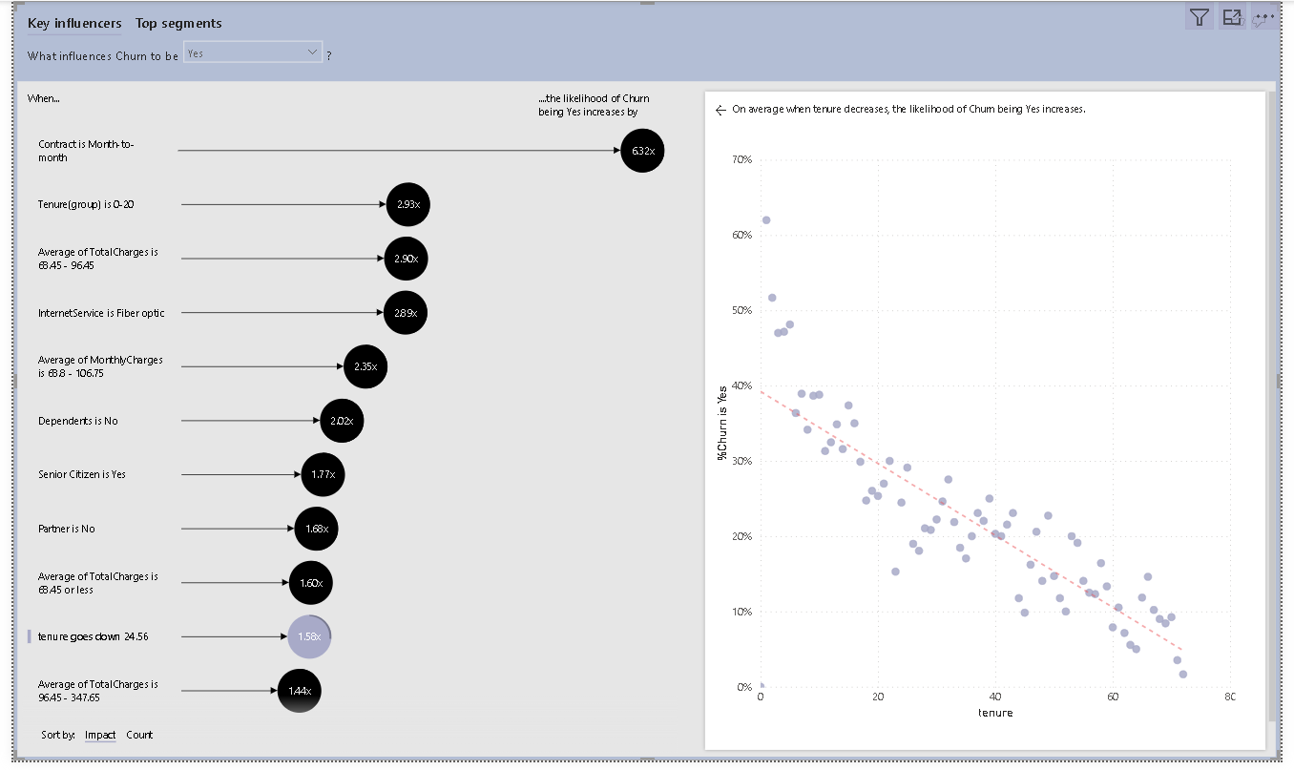

Slide 18
The top 6 influencers of customer churn in the company are
Tenure
Month-to-month contracts
Number of tech tickets
Online Security
Tech Support
Fiber optic as internet service

Slide 19
With the greatest key influencer being tenure!
When tenure decreases, the likelihood of customer churn increases.
Customer churn is likely to occur among customers who have month-to-month contracts.
When a customer has no online security, they are likely to leave the company.
Where no tech support is offered, customers are more likely to leave the company.
Churn is likely to occur among customers who have signed up for fiber optic as their internet service.

Slide 20
Recommendations
Pay close attention to new clients( less than 20 months). Offer them services that will hook them to the company so they stay with the company longer.
Make one or two year contracts more attractive to customers compared to the month-to-month contracts so that customers don’t find it fit to leave the company before the contract period is over. This will also make them stay longer increasing their tenure.
Find innovative ways of providing customers with online security and boost their confidence in the systems and the company in general.
Employ more tech staff to offer sufficient tech support to all clients.
Provide customers with diversified internet services so they have options other than fiber optic and DSL.

Slide 21

Thank You

